Slide 1

LT Spice
WIP Workshop
By: Luis Haro

Slide 2
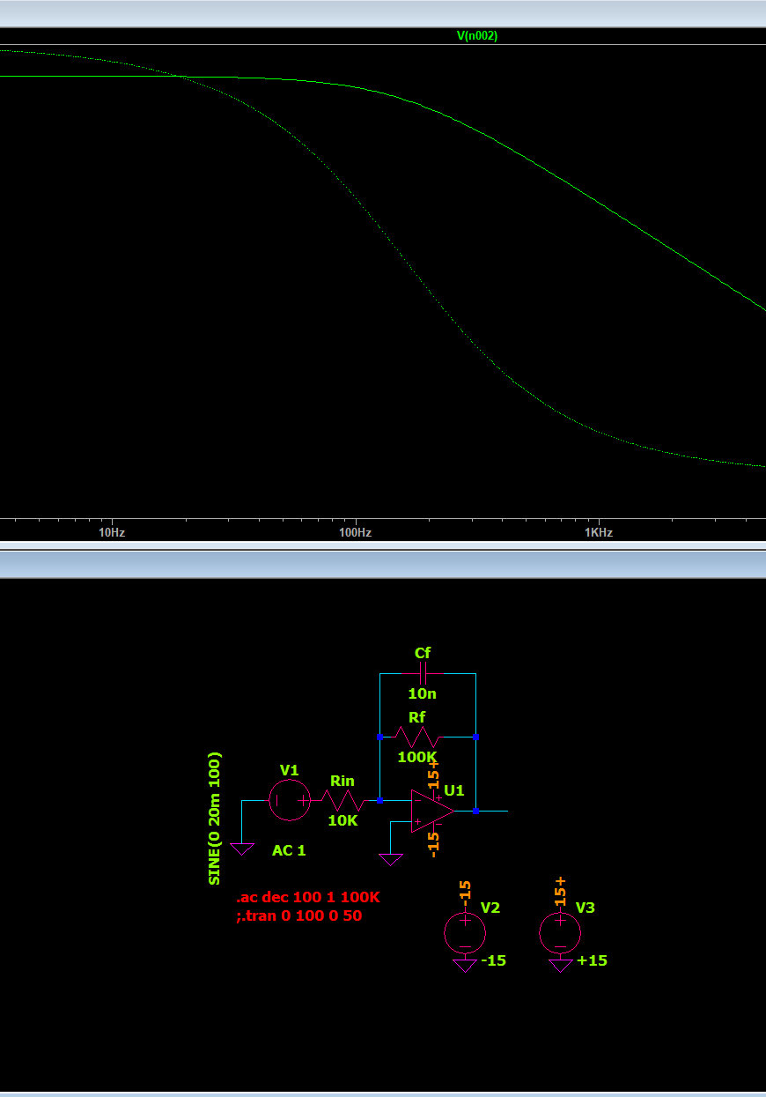
Inverting Active Low-pass Filter
An active low-pass filter uses an op-amp, resistors, and a capacitor.
Allows low-frequency signals to pass while attenuating high-frequency signals.
The op-amp amplifies and inverts the input signal.
The feedback capacitor controls the frequency response.
Applications: noise reduction, sensor conditioning, and audio filtering.

Slide 3
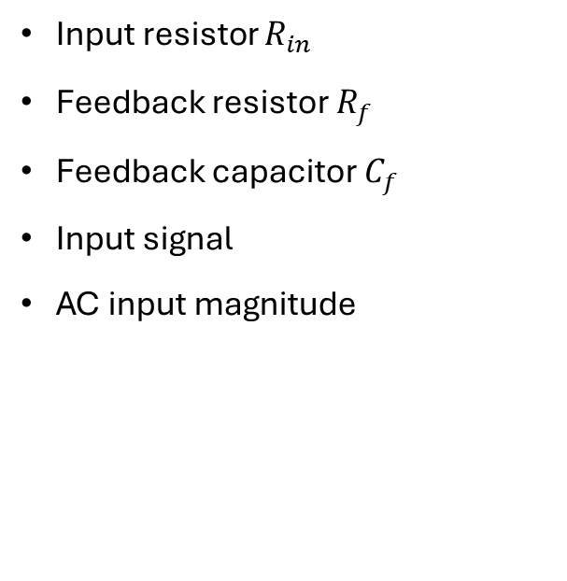
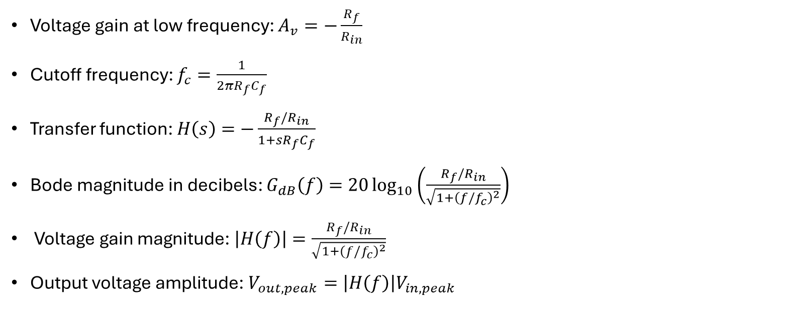
Components & Equations
Input resistor $R_{in}$
Feedback resistor $R_{f}$
Feedback capacitor $C_{f}$
Input signal
AC input magnitude
Voltage gain at low frequency: $A_{v}=−\frac{R_{f}}{R_{in}}$
Cutoff frequency: $f_{c}=\frac{1}{2πR_{f}C_{f}}$
Transfer function: $H\left(s\right)=−\frac{R_{f}/R_{in}}{1+sR_{f}C_{f}}$
Bode magnitude in decibels: $G_{dB}\left(f\right)=20\log_{10}\left(\frac{R_{f}/R_{in}}{\sqrt{1+{\left(f/f_{c}\right)}^{2}}}\right)$
Voltage gain magnitude: $\left|H\left(f\right)\right|=\frac{R_{f}/R_{in}}{\sqrt{1+{\left(f/f_{c}\right)}^{2}}}$
Output voltage amplitude: $V_{out,peak}=\left|H\left(f\right)\right|V_{in,peak}$

Slide 4
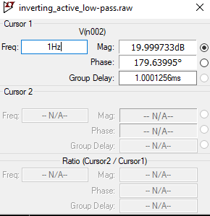
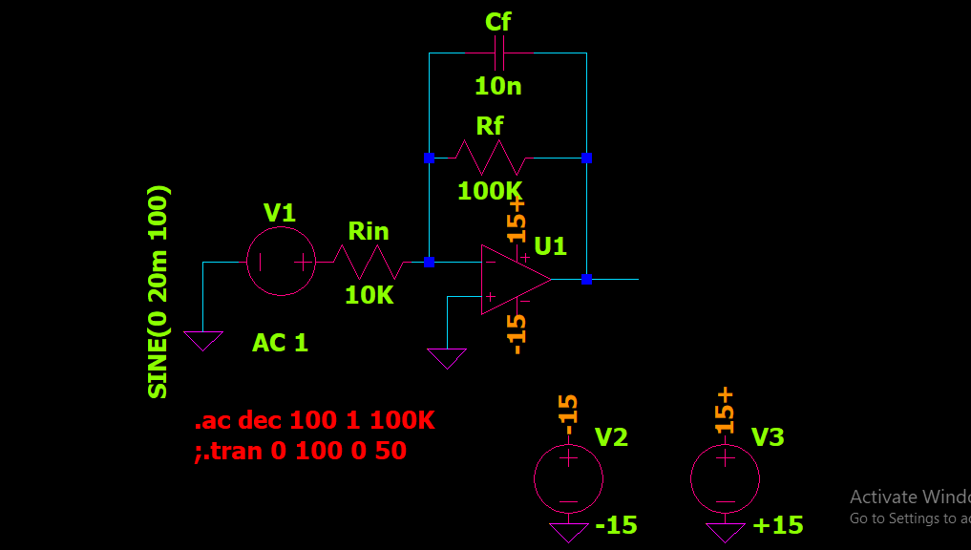
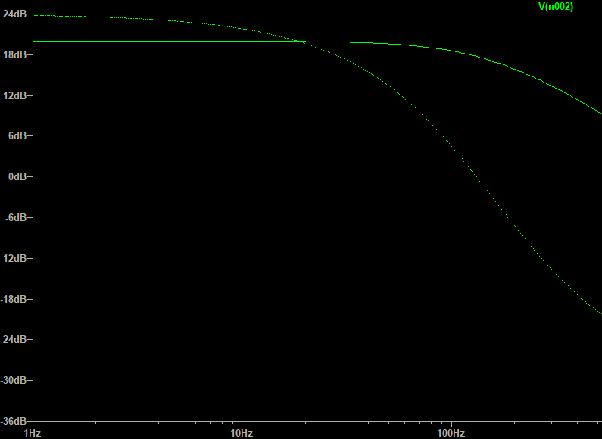
Inverting Active Low-pass Filter

Slide 5
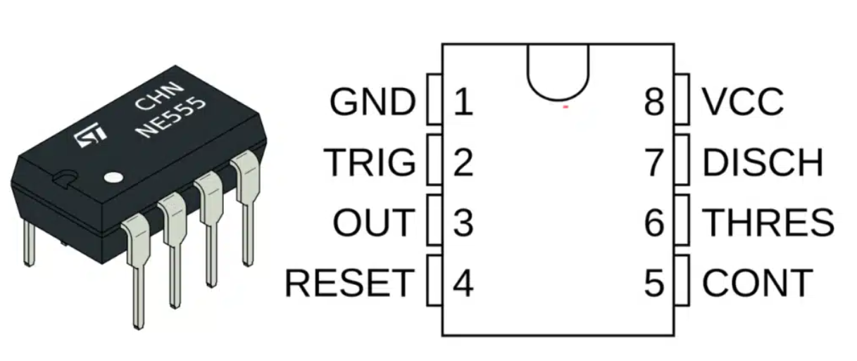
NE555 Timer Circuit
Design using Datasheet
Datasheet: https://www.ti.com/lit/ds/symlink/ne555.pdf?ts=1792616915775&ref_url=https%253A%252F%252Fwww.ti.com%252Fproduct%252FNE555

Slide 6
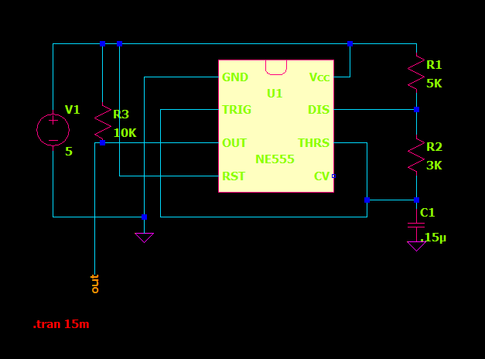
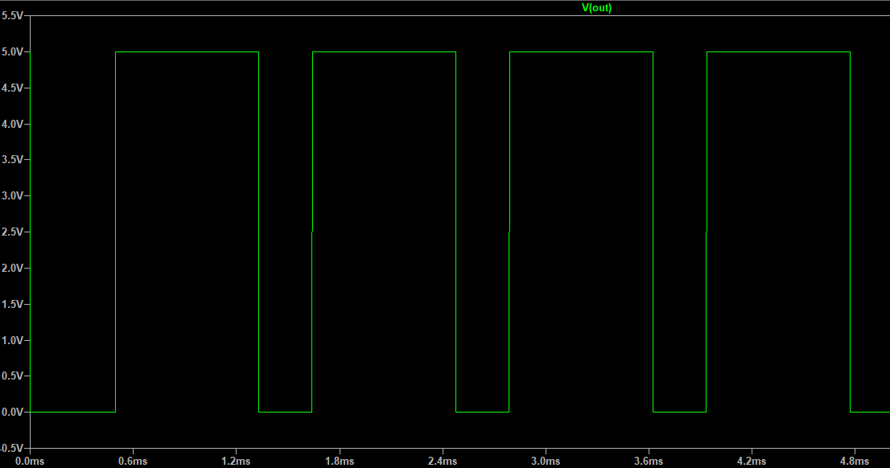
NE555 Timer Schematic

Slide 7
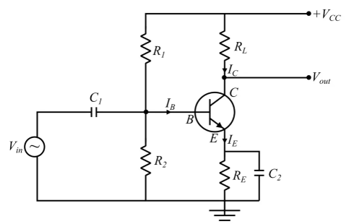
BJT common-emitter amplifier
A common-emitter amplifier uses a Bipolar Junction Transistor (BJT), resistors, and capacitors to amplify electrical signals.
A small input signal applied to the base controls a larger current flowing between the collector and emitter.
The transistor amplifies and inverts the input signal, producing an output with approximately a 180° phase shift.
The resistors establish the transistor's operating point, while the capacitors couple AC signals and can increase amplification.
Applications: Audio amplification, sensor signal conditioning, radio-frequency amplification, and communication systems.

Slide 8
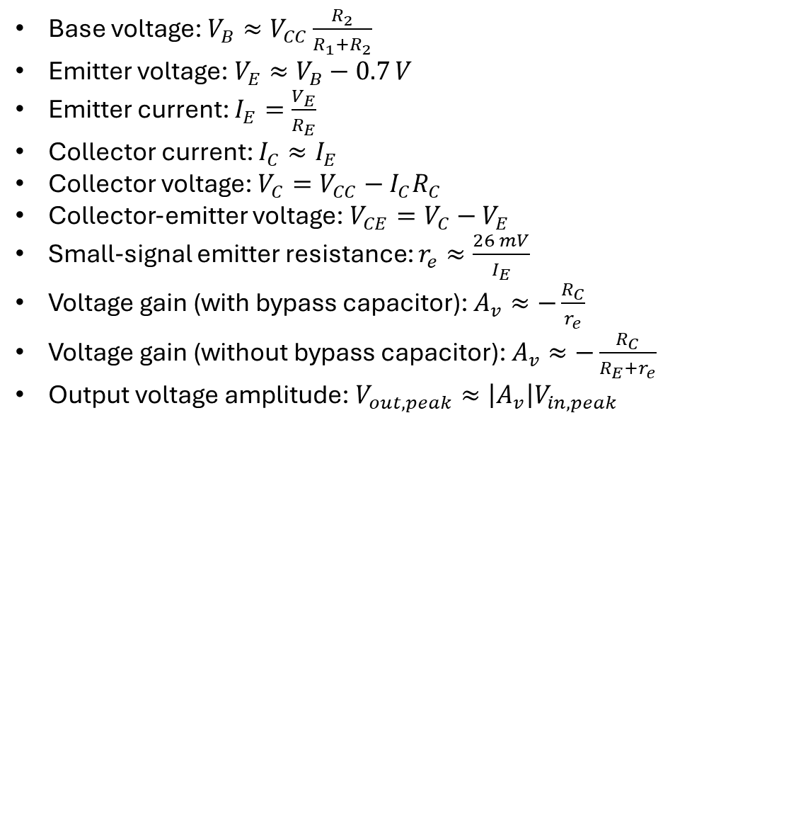
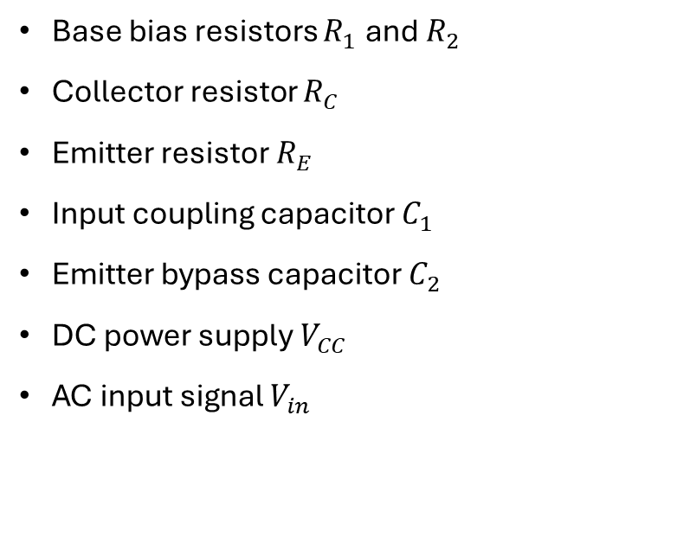
Components & Equations
Base bias resistors $R_{1}$ and $R_{2}$
Collector resistor $R_{C}$
Emitter resistor $R_{E}$
Input coupling capacitor $C_{1}$
Emitter bypass capacitor $C_{2}$
DC power supply $V_{CC}$
AC input signal $V_{in}$
Base voltage: $V_{B}≈V_{CC}\frac{R_{2}}{R_{1}+R_{2}}$
Emitter voltage: $V_{E}≈V_{B}−0.7 V$
Emitter current: $I_{E}=\frac{V_{E}}{R_{E}}$
Collector current: $I_{C}≈I_{E}$
Collector voltage: $V_{C}=V_{CC}−I_{C}R_{C}$
Collector-emitter voltage: $V_{CE}=V_{C}−V_{E}$
Small-signal emitter resistance: $r_{e}≈\frac{26 mV}{I_{E}}$
Voltage gain (with bypass capacitor): $A_{v}≈−\frac{R_{C}}{r_{e}}$
Voltage gain (without bypass capacitor): $A_{v}≈−\frac{R_{C}}{R_{E}+r_{e}}$
Output voltage amplitude: $V_{out,peak}≈\left|A_{v}\right|V_{in,peak}$

Slide 9
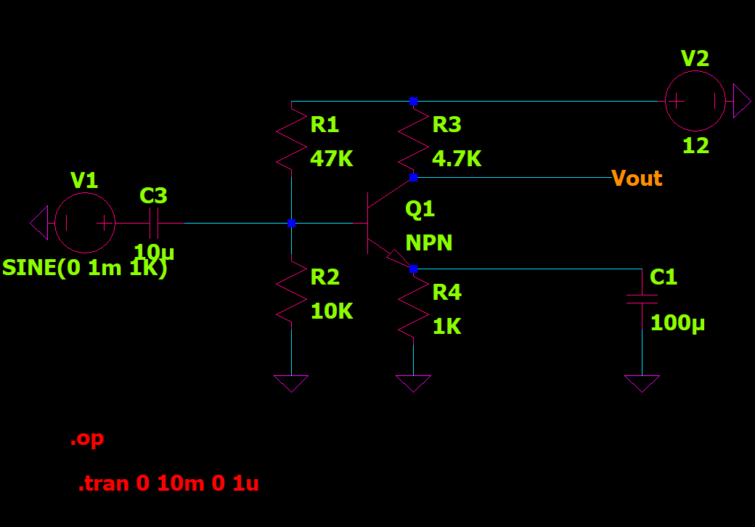
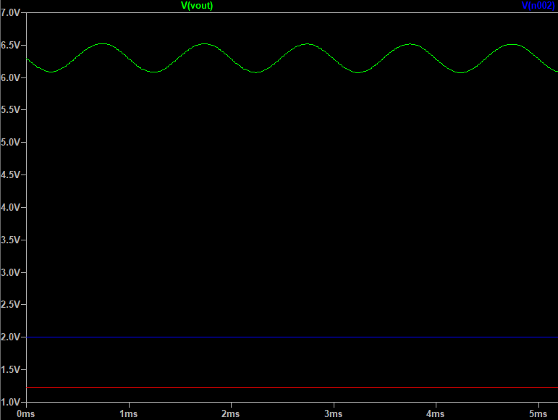
BJT common-emitter amplifier

Slide 10
AD4000 ADC
Design using Datasheet
Datasheet: https://www.analog.com/media/en/technical-documentation/data-sheets/AD4000-4004-4008.pdf?utm

Slide 11
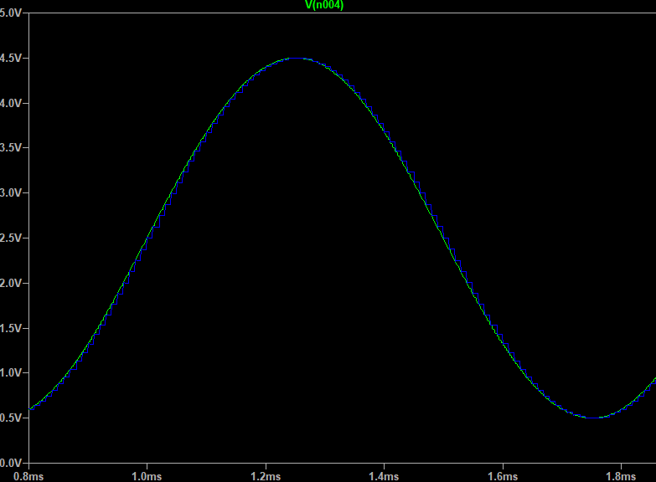
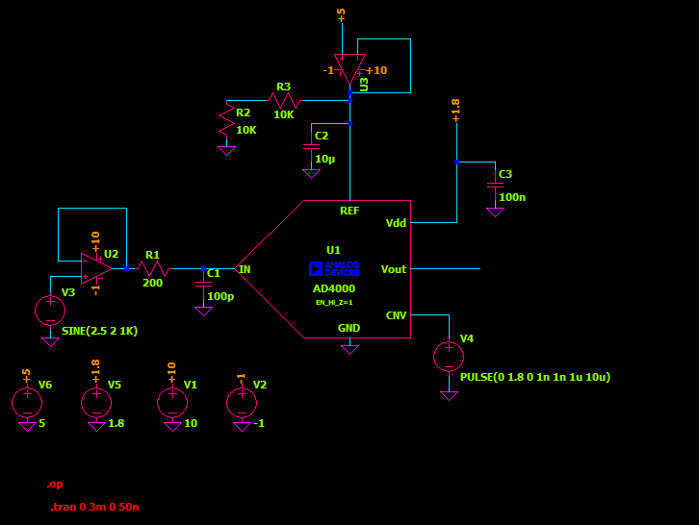
AD4000 schematic

Slide 12
Links
Op Amp Cookbook: https://e2e.ti.com/cfs-file/__key/communityserver-discussions-components-files/14/CircuitCookbook_2D00_OpAmps.pdf
Inverting Low-pass Filter: https://www.youtube.com/watch?v=h5g7BRYW8Zs
Active filters: https://www.youtube.com/watch?v=D32xE9Y8G0M
BJT common-emitter amplifier: https://www.electronics-tutorials.ws/amplifier/amp_2.html

